Slide 1
SENSOR READINGS FROM A WALL-FOLLOWING ROBOT DATA COLLECTED FROM A ROBOT WHILE NAVIGATING AROUND A ROOM
Course: Machine Learning 2
Student: Mobina Alinaghian
Student Number: S5905100

Slide 2
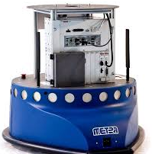
INTRODUCTION
Dataset: https://www.kaggle.com/datasets/uciml/wall-following-robot/data
The data were collected as the SCITOS G5 navigated through the room following the wall in a clockwise direction, for 4 rounds.
To navigate, the robot uses 24 ultrasound sensors arranged circularly around its "waist".

Slide 3
The original robot has 24 sensors, but the dataset simplifies these measurements into four distances representing the front, left, right, and back sides of the robot.
The dataset contains four input features:
Front Distance
Left Distance
Right Distance
Back Distance
These values represent the minimum measured distance in each direction around the robot.

Slide 4

Dataset

Slide 5
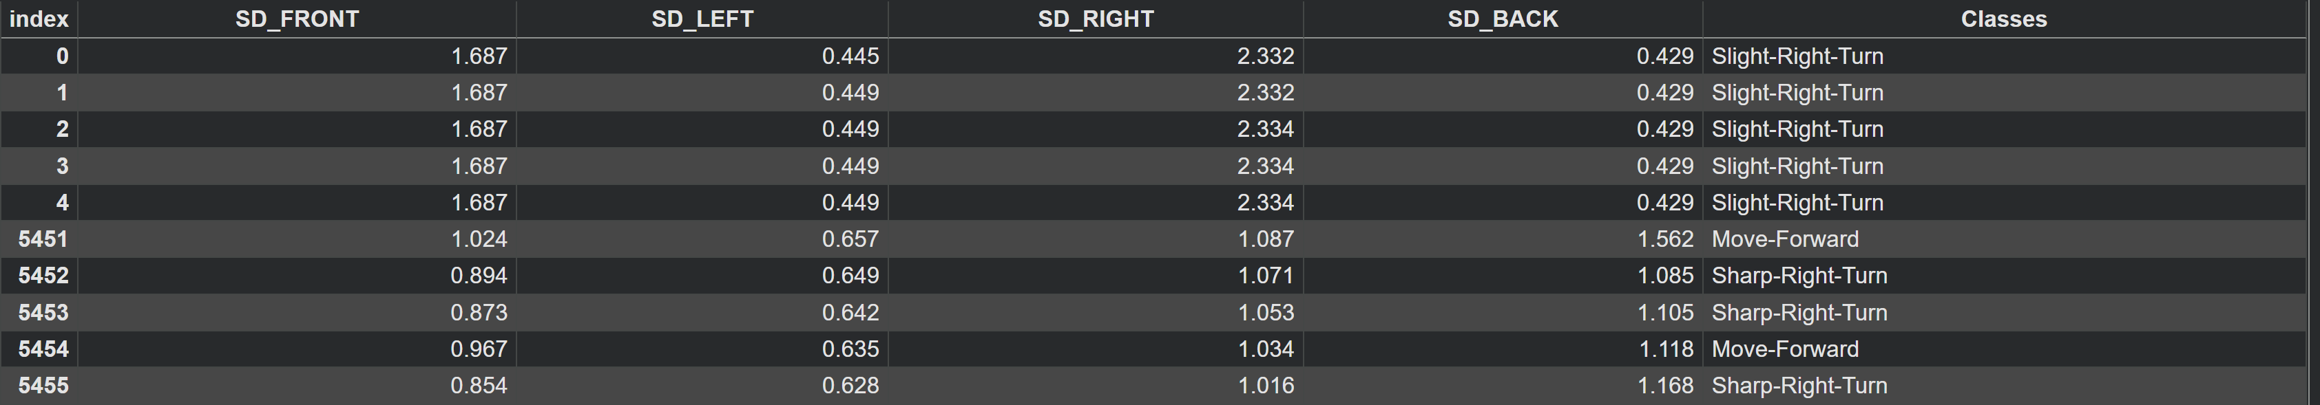
The full structure of the dataset has 5456 instances.
Each instance contains four sensor readings and one class label representing the robot's action.
For each instance, the corresponding class label is given:
Move-Forward
Slight-Right-Turn
Sharp-Right-Turn
Slight-Left-Turn
Arrangement: 5456 x 5 (4 sides + 1 class label)

Slide 6

IMPLEMENTATION

Slide 7
I am implementing two distinct machine learning algorithms, each representing different aspects of non-linear modeling:
Support Vector Classifier (SVC)
Random Forest
I trained the models using default fixed parameters. And then with a grid search process to optimize the hyperparameters of the algorithm.
Finally, I evaluated the models using accuracy and confusion matrices.

Slide 8
PRE-PROCESSING
The dataset is imported from a .csv file and loaded into the environment.
Data is then split into 3 subsets:
the training phase (70%)
the test phase (15%)
the validation phase (15%)
Apply the scaler to transform the training set and use the same scaler to transform the test and validation sets.

Slide 9
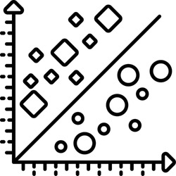
SVC
(SUPPORT VECTOR CLASSIFIER)

Slide 10
2D classification is projected into a higher dimension to find an optimal hyperplane to separate.
The model's linearity is influenced by the gamma parameter, while the regularization parameter C controls the trade-off between margin width and misclassification rate.
With the grid search approach, it is possible to tune the two parameters (gamma and C).

Slide 11
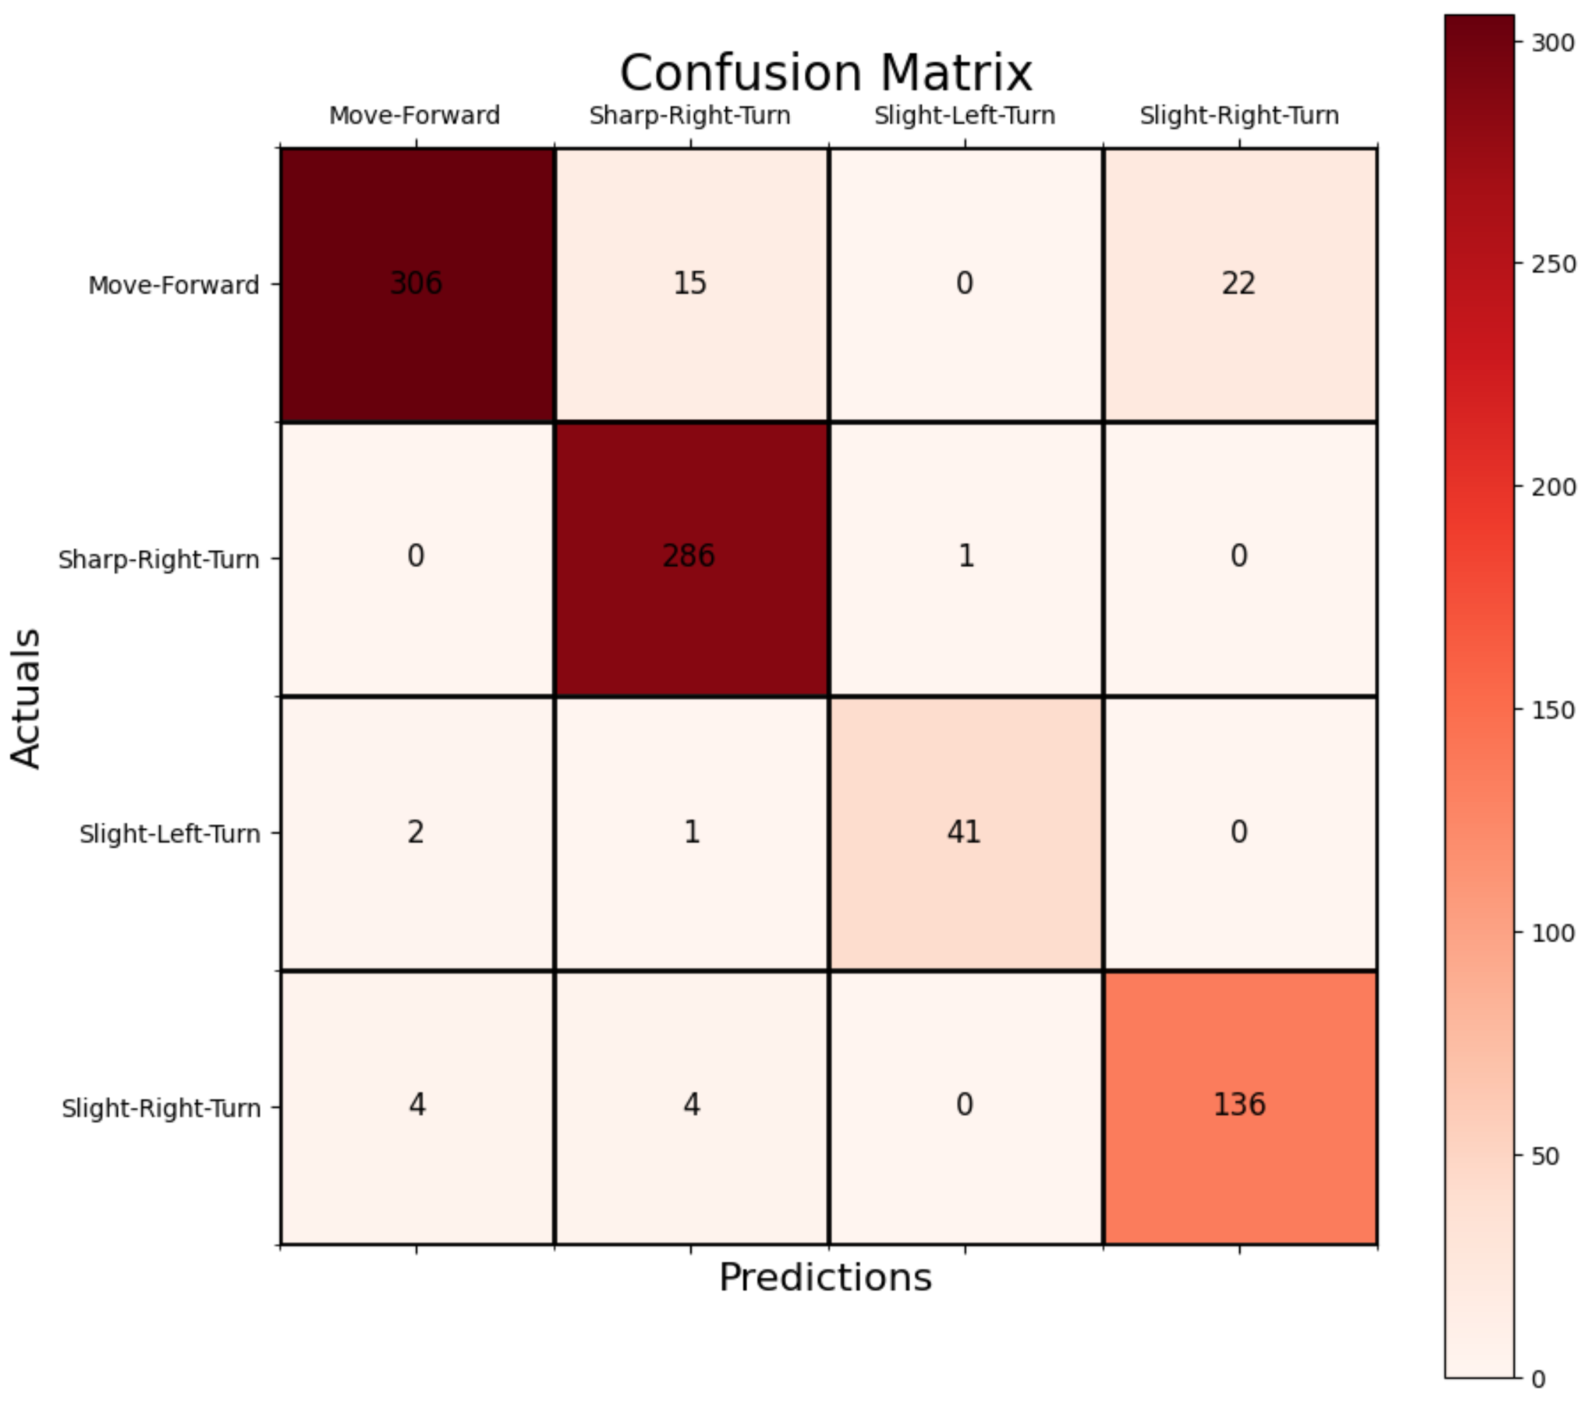
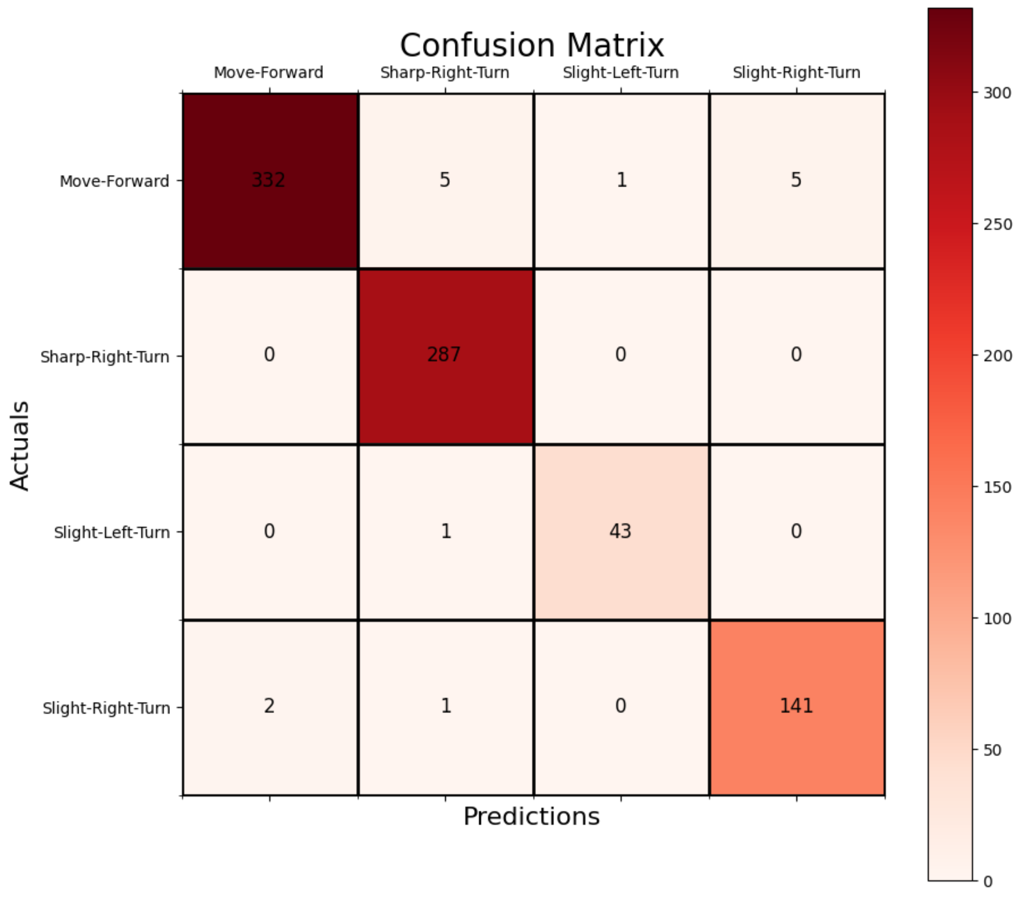
Without Grid Search
With Grid Search
SVC accuracy on test data is: 94.01 %
Successful Navigation Rate: 94.01 %
Collision Rate: 5.99 %
One-vs-Rest SVC accuracy on test data is: 98.11 %
Successful Navigation Rate: 98.17 %
Collision Rate: 1.83 %

Slide 12
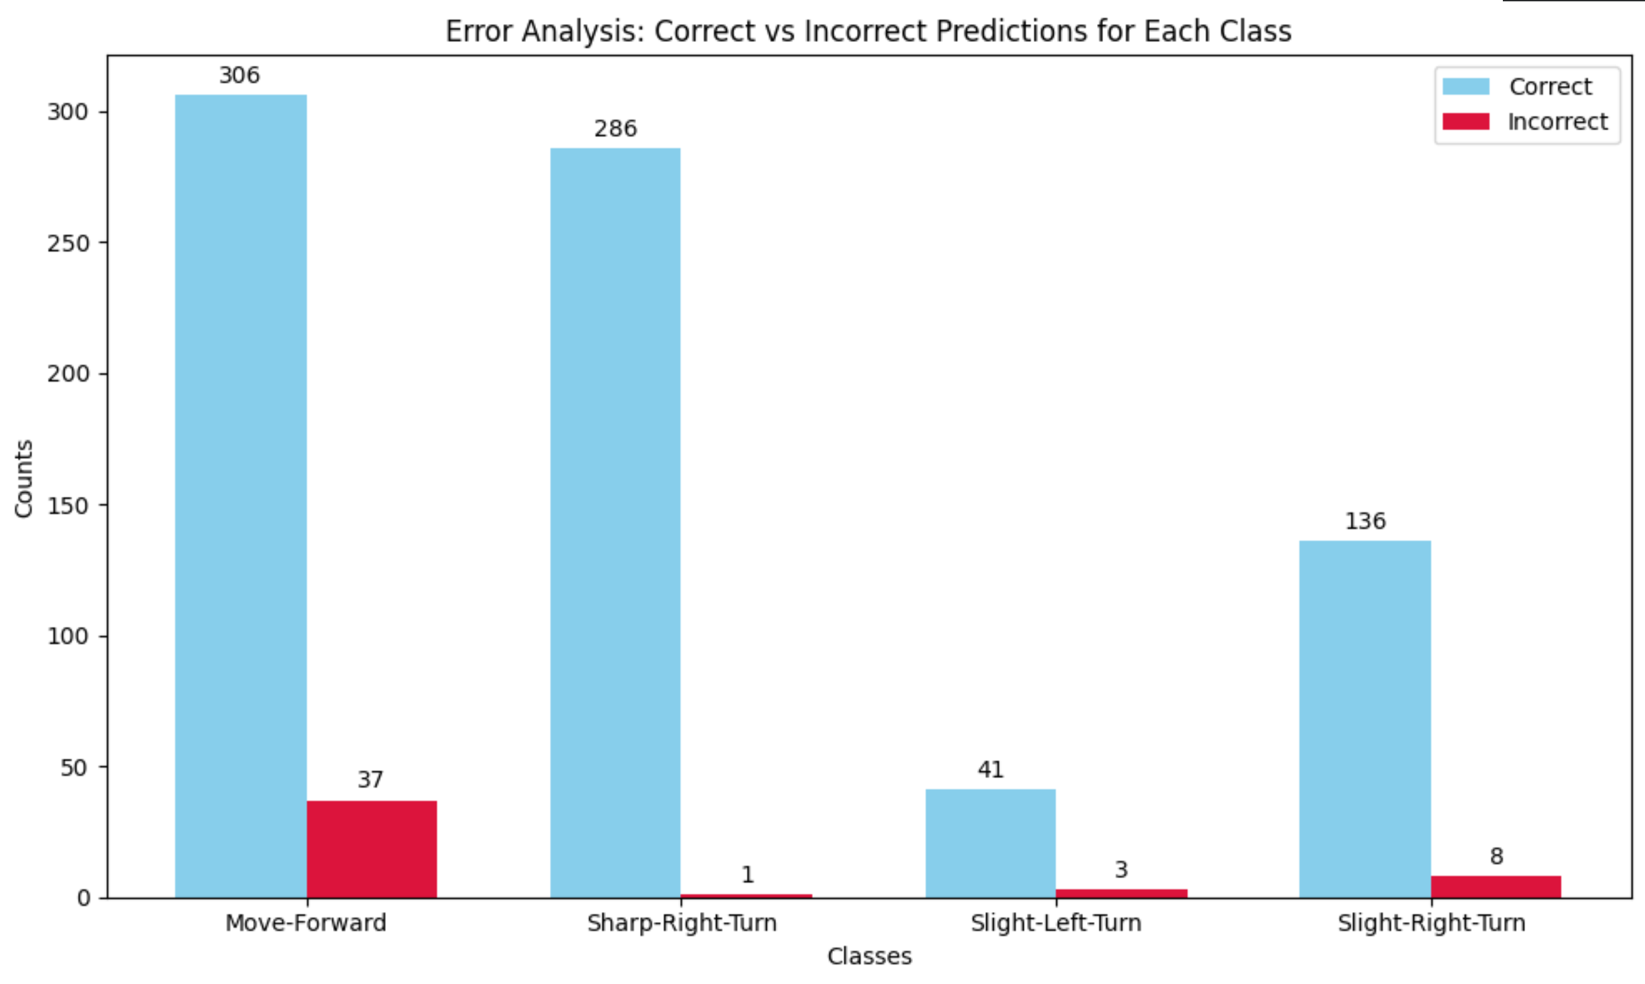
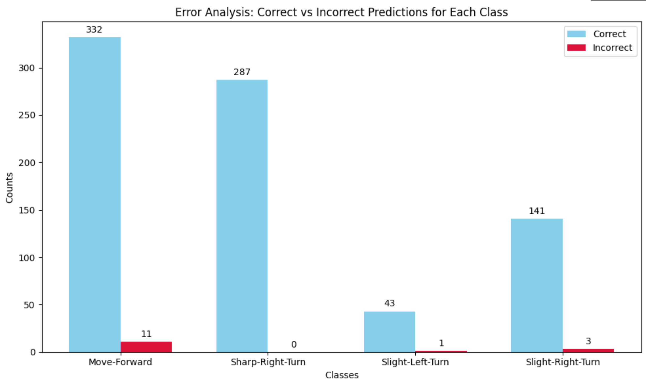
Without Grid Search
With Grid Search

Slide 13
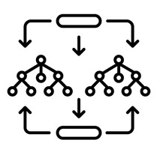
RANDOM FOREST

Slide 14
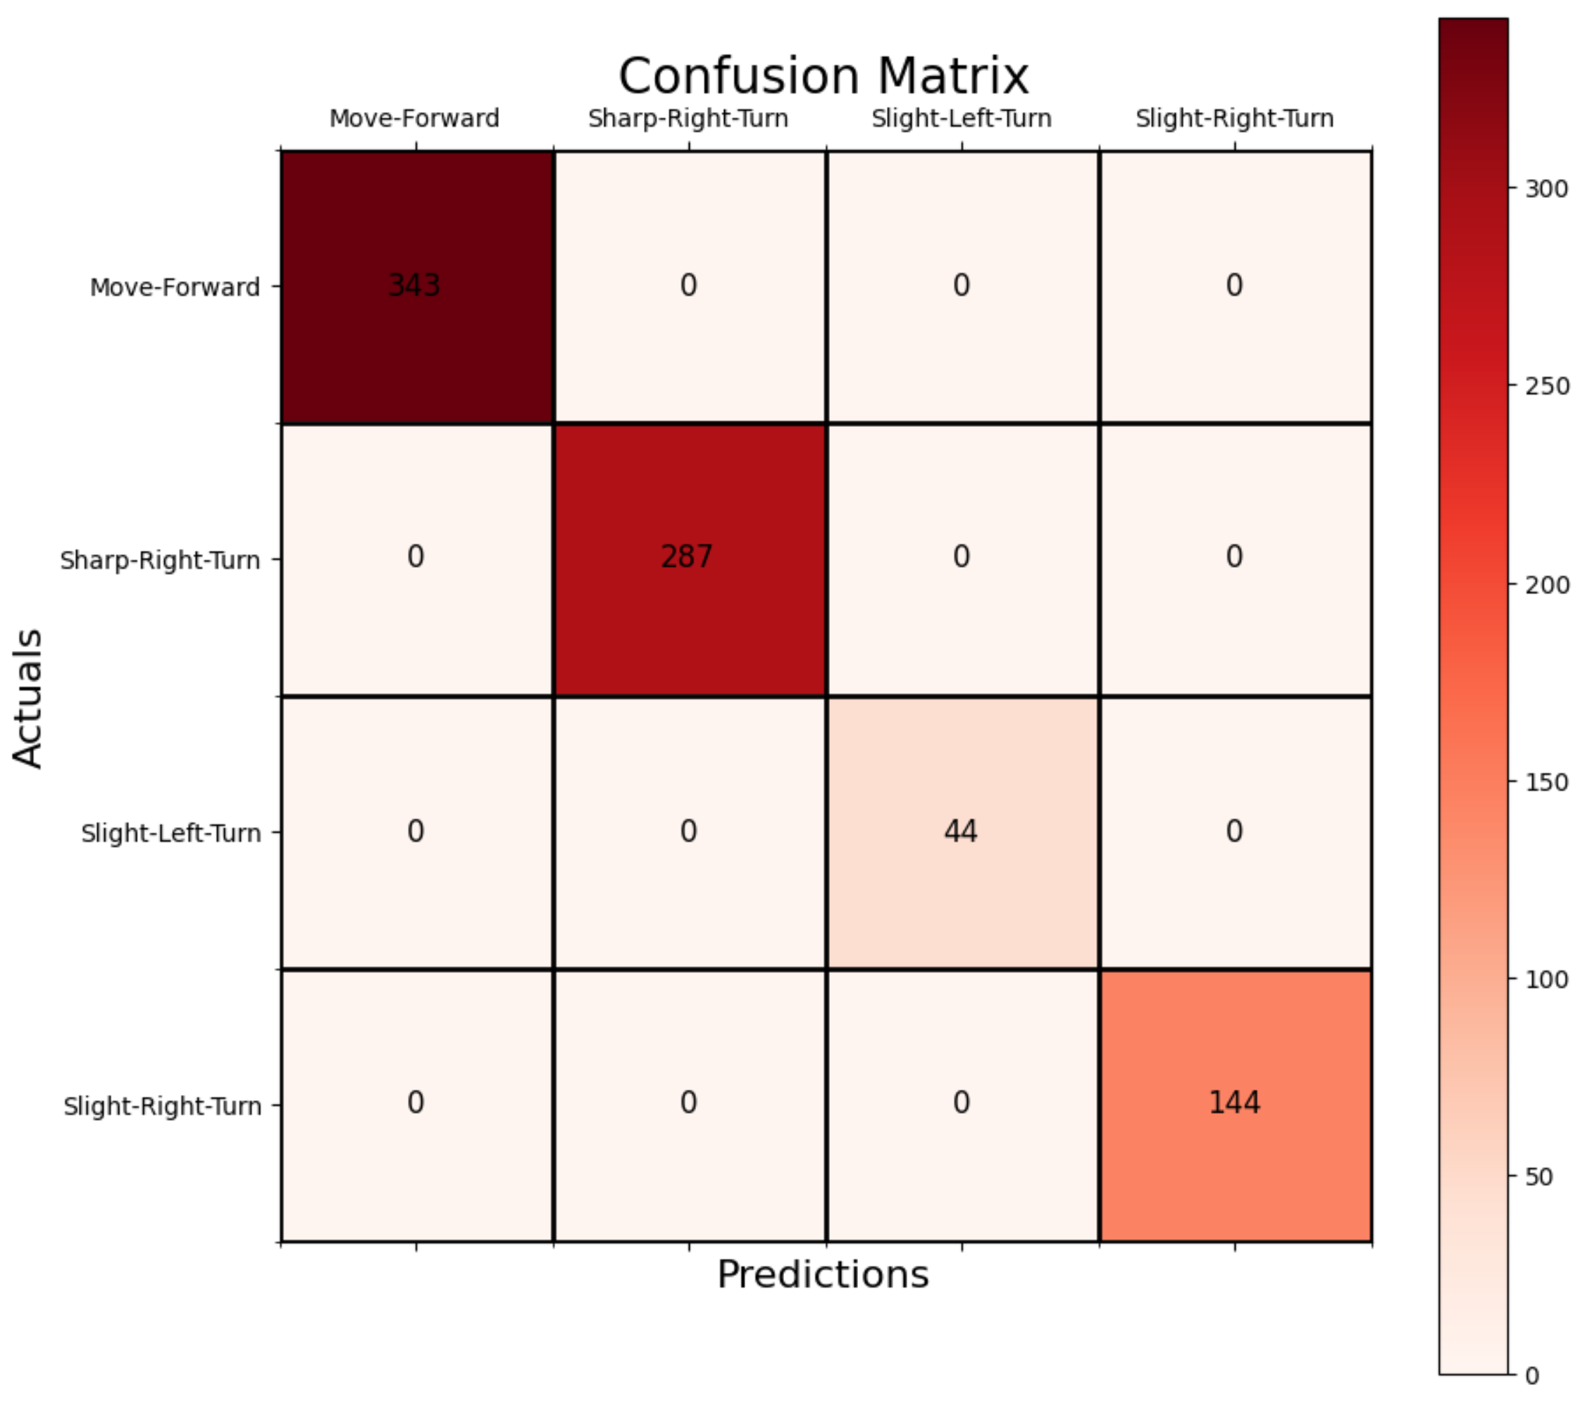

Without Grid Search
With Grid Search
Random Forest accuracy on test data is: 100.00 %
Successful Navigation Rate: 100.00 %
Collision Rate: 0.00 %
Random Forest accuracy on test data is: 100.00 %
Successful Navigation Rate: 100.00 %
Collision Rate: 0.00 %

Slide 15
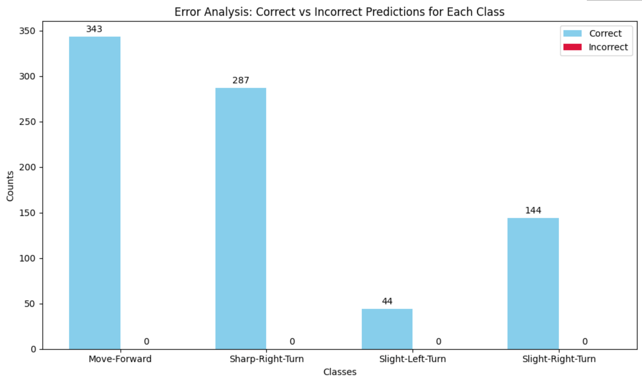

Without Grid Search
With Grid Search

Slide 16
CONCLUSION
Based on the analysis of the results, it can be concluded that the most challenging classes to predict are “slight right turn” and “move forward,” as shown in the error analysis.
The Support Vector Classifier (SVC) performance is highly dependent on the choice of hyperparameters, which significantly influences its accuracy. Overall, the Random Forest algorithm demonstrated the highest performance between the evaluated models.

Slide 17
Thank you
Mobina Alinaghian

